Slide 1


Cybersecurity made simple:

Slide 2
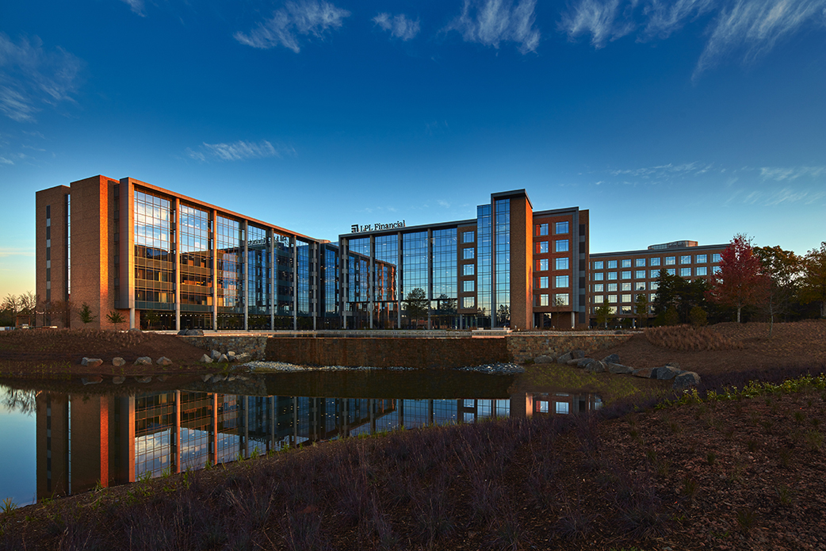
agenda
01 Protecting Your Information
02 Cyber-attacks & Scams
03 Securing Your Accounts
04 Protecting Your Family
556763

Slide 3
Protecting Your information

Slide 4
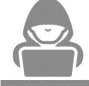
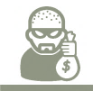
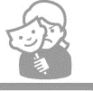
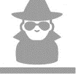
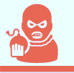
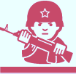
What is cybersecurity
Cybercriminals
Who are behind cyber-attacks?
Hacktivism
Social or Political Interests
What is it?
Cybersecurity is the art of protecting networks, devices, and data from unauthorized access or criminal use and the practice of ensuring confidentiality, integrity, and availability of information.
Why should you care?
Bad actors are constantly evolving their tactics to access information in unauthorized manners. Once they’ve received access, they will use the information to commit fraud.
Crime
Extortion or Financial Gain
Angry Employees
Financial or Personal Gain
Espionage
Info or Intellectual Property
Terrorism
Create Fear or Harm
Warfare
Sabotage critical public or military infrastructure
556763
LPL Financial Member FINRA/SIPC

Slide 5
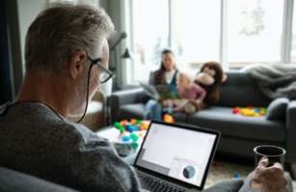
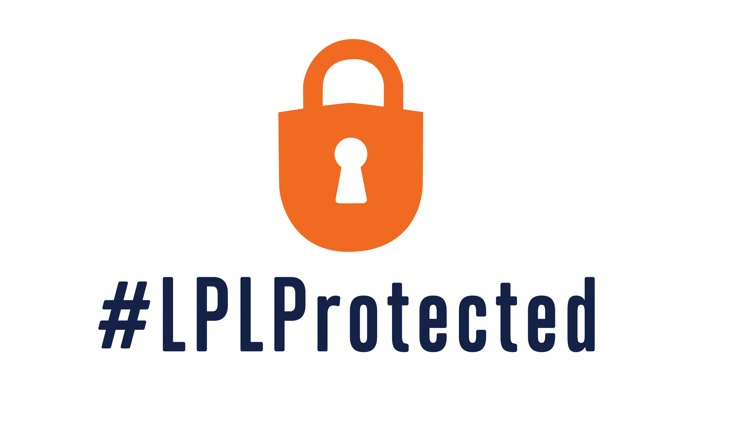
Keeping your information safe
We are committed to protecting your data
YOU | Clute Wealth Management | LPL Financial
Investment account | Recurring trainings | Dedicated cyber staff
Assets | Personal relationship | State of the art facilities
Personal information | Secure financial tools | Cyber insurance
556763

Slide 6

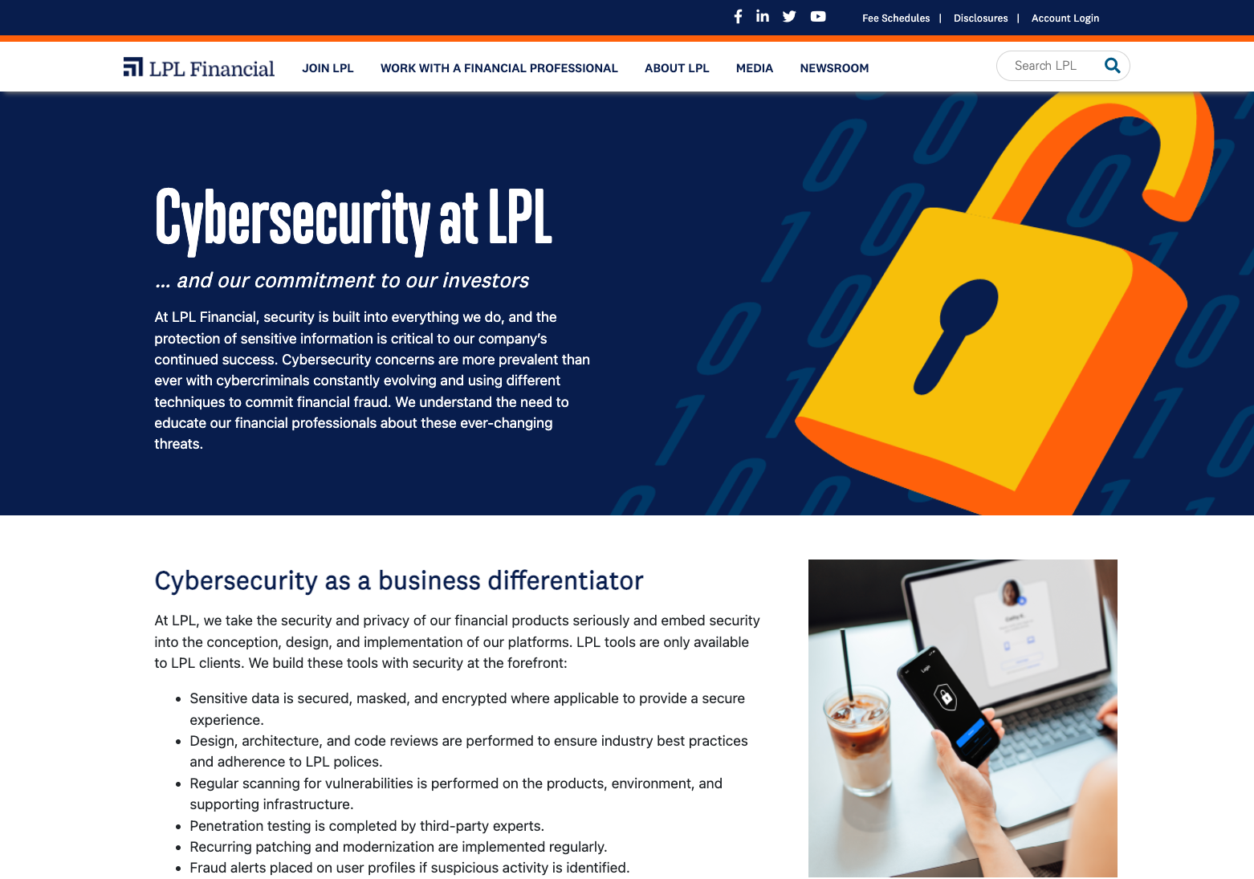
Lpl’s cyber fraud guarantee
Visit LPL’s cybersecurity page on LPL.com to learn more today!
“LPL will reimburse you for 100% of realized losses in your impacted LPL accounts, which were incurred directly as a result of unauthorized access to an LPL system.”
556763

Slide 7
Cyber-attacks and scams

Slide 8
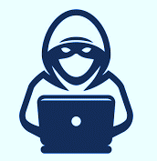
Social engineering attacks
These attacks are designed to take advantage of human emotions
1
Phishing – suspicious emails sent to large groups of individuals. The goal is to get the recipient to click a link or open attachments.
2
Ransomware – this malware or virus is often deployed after a link is clicked or attachment is opened in a phishing email.
3
Scams – Bad actors create realistic scams to trick unsuspecting individuals into exposing personal, financial, or corporate information.
4
Email Impersonations – An LPL client’s email is compromised and the bad actor does keyword searches to locate sensitive information.
556763

Slide 9

Phishing email red flags
Proceed forward with caution is you receive an email with a “red flag”
Unusual request
Unfamiliar tone to email
Suspicious links or attachments
Inconsistencies in email address, links and/or domain names
556763

Slide 10
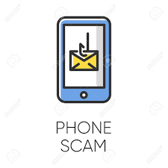
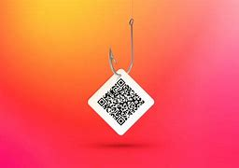
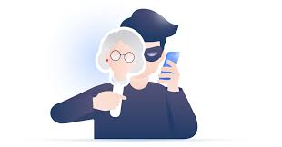
Phishing scams
Smishing
Vishing
Quishing
556763

Slide 11
Smishing
Quishing
Vishing
556763

Slide 12
Vishing
Smishing
Quishing
556763

Slide 13
Quishing
Smishing
Vishing
556763

Slide 14
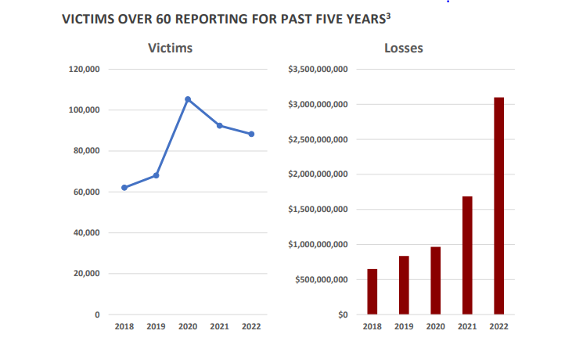
Elder Fraud
Cyber-attacks impact seniors more than other demographics
Examples of senior scams:
Romance/Confidence
Tech support
Lottery/Sweepstakes
Inheritance
Identify Theft
Government Impersonation
Investment
Healthcare
If you’re unsure if your interaction is legitimate, immediately cease that interaction.
*Per Elder Fraud Report via the FBI
*Per 2021 Elder Fraud Report
Customer Service/Tech Support scams impacted the most victims
556763
LPL Financial Member FINRA/SIPC

Slide 15

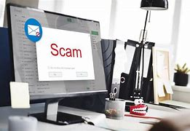
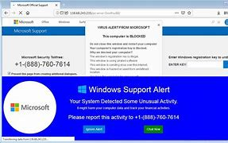
Beware of scams
Investment scams
Invoice scams
Tech Support scams
556763

Slide 16
What do I do next?
It is crucial to act quickly to minimize impact
1
Change your passwords – Phishing attacks often gain access to accounts and credentials. Always update your passwords and accounts if you are a victim of phishing.
2
Check your accounts – Be sure to monitor and check your accounts for unusual or unauthorized activity to accounts including banking, email, and social media.
3
Notify LPL / IT – Notifying LPL of an attack or compromise allows us to monitor your accounts and setup controls to protect your clients.
4
Educate – Education on phishing attacks is crucial to protecting your accounts. Adopting a proactive response to phishing attacks can save you many issues.
556763

Slide 17
Securing your accounts

Slide 18
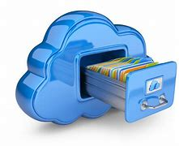
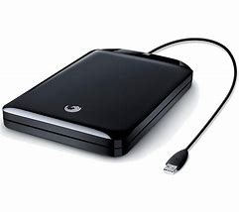
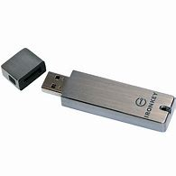
Backing up data
These convenient options allow you to store data in a secondary place
1
2
3
Cloud storage
External hard drive
Encrypted USB drive
556763

Slide 19
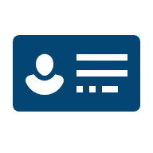


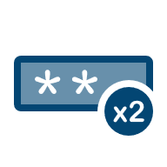

Password security tips
Prioritize length and complexity with your passwords
Don’t use personal information.
This can be publicly available & easily accessible by hackers.
Avoid using dictionary words.
Password-cracking tools can easily process every word in the dictionary.
Use multi-factor authentication (MFA or 2FA).
For especially sensitive accounts, enable and use MFA.
Don’t re-use passwords.
If one account is breached, your others would be vulnerable as well.
Avoid typing passwords while using public Wi-Fi.
Use a VPN or avoid websites that require your login information.
556763

Slide 20
Is your password strong enough?
How long would it take hackers to compromise your password?
Characters | Numbers Only | Lowercase Letters | Upper and Lowercase Letters | Numbers, Upper and Lowercase Letters | Numbers, Upper and Lowercase Letters, Symbols
4 | Instantly | Instantly | Instantly | Instantly | Instantly
6 | Instantly | Instantly | Instantly | Instantly | Instantly
8 | Instantly | Instantly | 28 secs | 2 mins | 5 mins
10 | Instantly | 1 mins | 21 hours | 5 days | 2 weeks
12 | 1 secs | 14 hours | 6 years | 53 years | 226 years
14 | 52 secs | 1 year | 17k years | 202k years | 1m years
16 | 1 hours | 713 years | 46m years | 779m years | 5bn years
18 | 6 days | 481k years | 126bn years | 2tn years | 26tn years
556763

Slide 21
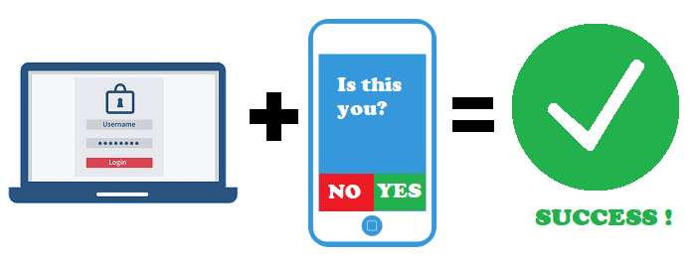
Multi-factor authentication (mfa)
Use multi-factor authentication to add an additional layer of security to your accounts.
What is MFA?
MFA is an authentication method that requires you to complete two methods of verification to gain access to an application.
556763

Slide 22
Protecting your family

Slide 23
Internet best practices
Misuse of the internet can lead to increased risks from cyber threats.
Keep browsers and plugins up to date
Always use VPN if connected to public Wi-Fi
Use credit cards or third-party apps for payments
Only share sensitive information on legitimate, secure websites
556763

Slide 24




Stay safe with these mobile device tips
Mobile devices can be found in nearly every American’s pocket. How safe is your device?
Update software regularly
Only install known and trusted apps from official app stores
Use mobile security software
Turn on user authentication and use strong passwords
556763

Slide 25
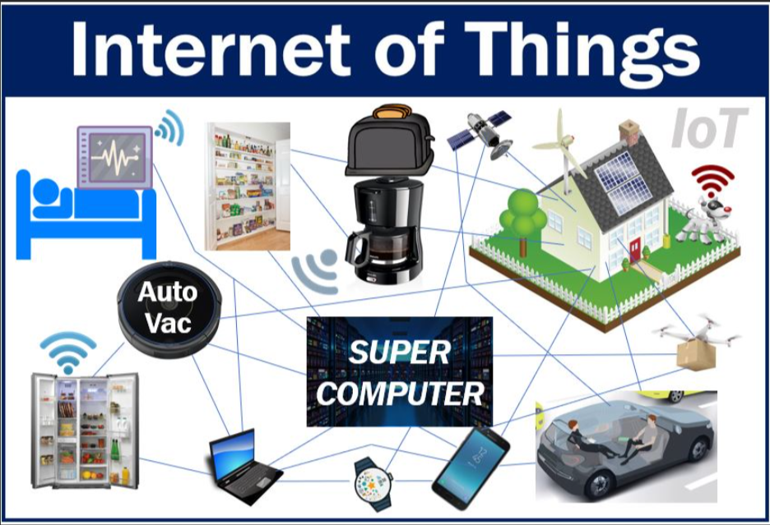
Securing your home
If you connect it, protect it!
Best Practices
Best Practices
Update software regularly
Change default passwords to strong, complex passwords
Use a password manager
Enable MFA
Opt-out of data tracking
Update software regularly
Change default passwords to complex passwords, patterns, or pins.
Ensure each device has unique password
Enable MFA
Opt-out of data tracking
Any device that has a sensor and is connected to the internet is an IOT
556763

Slide 26
Traveling safe
Always value security over convenience
Stay vigilant
Use a portable charger
Learn about local scams
Avoid public Wi-Fi
556763

Slide 27

Protecting your identity
Make keeping your personal information safe a priority.
Freeze your credit
Review account activity regularly
Beware of phishing emails
Use strong passwords
556763

Slide 28
Protecting your family
The use of technology to harass, threaten, embarrass, or target a person is called cyberbullying.
Discuss cyber-bullying
Proactively learn about cyber-threats
Take precautions on social media
Consider creating a “password”
556763

Slide 29
Call to action
We challenge you to make a change based off the information you just learned
LPL is committed to working with your advisor’s office.
Social engineering attacks take advantage of your emotions.
Don’t click on links or open attachments from unknown sources.
Value security over convenience.
Protect your accounts and protect your family.
1.
2.
3.
4.
5.
556763

Slide 30
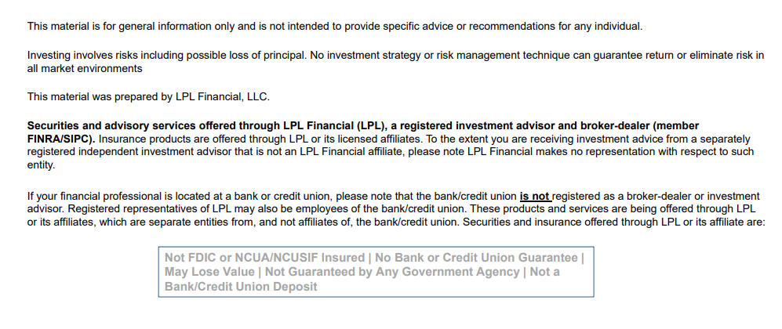
Not Insured by FDIC/NCUA or Any Other Government agency | Not Bank/Credit Union Guaranteed | Not Bank/Credit Union Deposits or Oblligations | May Lose Value
556763

Slide 31
Thank YoU
556763

